Slide 1
Multiple Grid Energy Consumption of Data Centres
Course: Data Integration
Philipps University Marburg
Team members:
Indrit Berbiu
Hicham Babahmed
Amra Dadic
Marburg, 10.5.2023.

Slide 2
Goals
Analysis of energy consumption patterns of data centers
Comparing that data with data of solar energy production patterns of a solar farm
Identify opportunities to optimize energy usage and increase the percentage of off-grid solar energy supplied to the data centers

Slide 3
Goals
Incorporating weather data, such as cloud cover and temperature - understanding how weather conditions affect the amount of produced solar energy
Predict how much solar energy the data center will receive on a particular day and adjust energy consumption accordingly

Slide 4
Datasets
Solar Energy Production Data
hourly production of solar energy from a solar farm
Electricity Grid Data
information on the hourly electricity generation and consumption for different regions across the United States
Energy Consumption Data of Data Centers
energy consumption data of a data center located in the United States

Slide 5
Optimization strategies
Implement Energy Efficiency Measures
Utilize Renewable Energy Sources
By using energy-efficient servers, virtualization and cooling systems, energy consumption can be significantly reduced.This can be analyzed by datasets that provide informations on efficiency of different systems and equipment to identify improvement opportunities
Incorporating solar or wind energy helps reduce their reliance on traditional electricity grids
GOAL
Analyze energy consumption patterns
By integrating these data sets and implementing these strategies, energy usage optimization can be performed in a data center and reduce costs while maintaining optimal performance.
By analyzing energy consumption patterns over time, trends and patterns can be identified that indicate areas where energy usage can be optimized

Slide 6
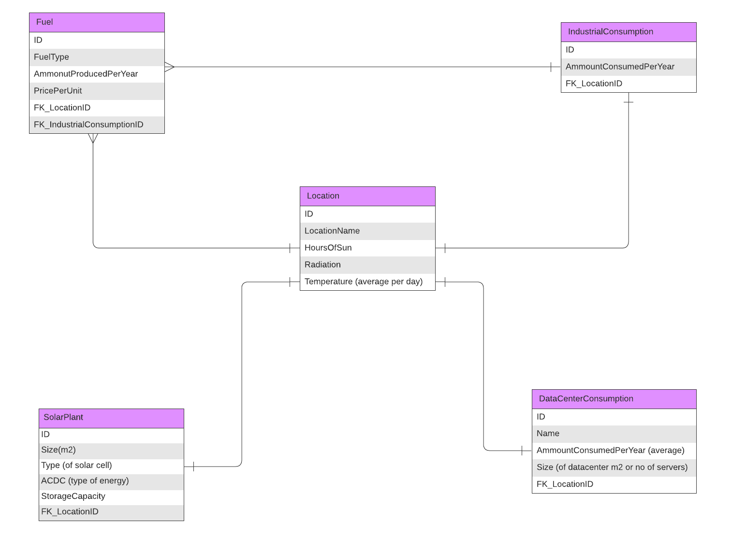
ERD

Slide 7
Thank you for your attention!

